Slide 1

DAYANANDA SAGAR UNIVERSITY
SCHOOL OF ENGINEERING
Department of Computer Science and Engineering
Artificial Intelligence and Machine Learning
GROUNDWATER LEVEL PREDICTION
Under the Supervision
Prof. Sasikala N
Department of Computer Science, DSU
1
Presented By:
Sinchana M (ENG22CS0170)
Sneha Ilager (ENG22CS0174)
Sneha MP (ENG22CS0175)
Spandana K R (ENG22CS0182)
Notes:
Title of the project
CSE Dept., SET-Jain University
1

Slide 2
Overview
Abstract
Introduction
Problem Statement
Objectives
Methodology
Algorithms used
Result
Conclusion
References
*
Dept of CSE., SOE-Dayananda Sagar University

Slide 3
Abstract
Groundwater is a crucial resource for agriculture, industry, and domestic use. Accurate prediction of groundwater levels is essential for sustainable water resource management.
This study explores the use of logistic regression to predict groundwater level categories (e.g., excess, semicritical, moderated, critical) based on historical and environmental data.
The proposed model provides a cost-effective and interpretable solution to aid decision-makers in water resource planning.
*
Dept of CSE., SOE-Dayananda Sagar University

Slide 4
Introduction
Groundwater levels fluctuate due to factors like precipitation, temperature, land use, and human activities. Traditional monitoring methods are resource-intensive and time-consuming.
Machine learning techniques, such as logistic regression and Random Forest, offer a data-driven approach to categorize groundwater levels.
Logistic regression is particularly suited for classification problems and can provide clear insights into the relationships between predictors and groundwater level categories.
*
Dept of CSE., SOE-Dayananda Sagar University

Slide 5
Problem Statement
Groundwater is crucial but increasingly at risk due to overuse and climate change. This study develops a cost-effective logistic regression model to predict and classify groundwater levels, aiding sustainable water management and decision-making.

Slide 6
Objectives
Primary Objective: Develop a logistic regression model to accurately classify groundwater levels into predefined categories.
Secondary Objective: Provide a cost-effective and interpretable tool to support sustainable water management and decision-making.

Slide 7
Methodology:
Data Collection: The dataset was sourced from Kaggle, containing parameters such as Total Rainfall, Irrigation, Domestic and industrial etc., uses which influence groundwater levels.
Data Preprocessing:
Missing values were handled to ensure the dataset's integrity.
Numerical features were standardised to bring all features to a comparable scale.
Categorical features were encoded using techniques like One-Hot Encoding and Label Encoding for model compatibility.
*
Dept of CSE., SOE-Dayananda Sagar University

Slide 8
3. Exploratory Data Analysis (EDA):
Key visualizations were performed to uncover patterns in the data:
Correlation heatmaps to identify relationships between variables.
Count plots and pair plots to explore data distribution.
Line and countplot charts to examine trends and proportions.
4. Data Splitting:
The dataset was divided into training and testing sets to evaluate model performance on unseen data.
A typical split ratio of 70:30 was used, ensuring the model was trained on a substantial portion while reserving some data for validation.

Slide 9
5. Model Implementation:
Logistic regression was implemented to classify groundwater levels into predefined categories.
An additional algorithm (e.g., Random Forest) was incorporated for performance comparison.
6. Model Evaluation:
Metrics such as accuracy, precision, and confusion matrix were calculated.
Mean Squared Error (MSE) was used to assess prediction errors.

Slide 10
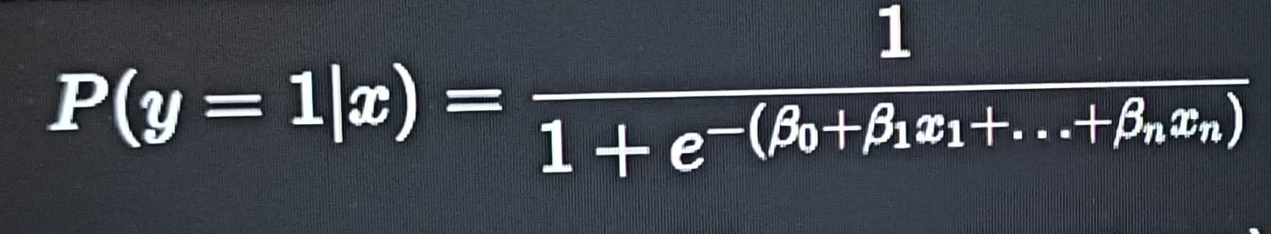
Algorithms used
Logistic Regression Algorithm
Logistic regression predicts the probability of an outcome belonging to a particular category.
The sigmoid function is used to map predictions to a range between 0 and 1.
The model optimizes the log-likelihood function during training.

Slide 11
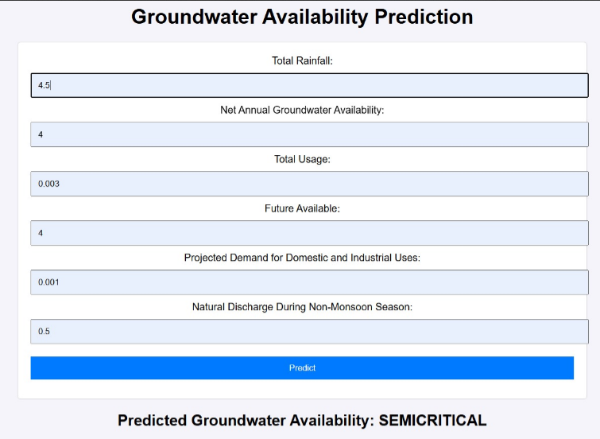
Result

Slide 12
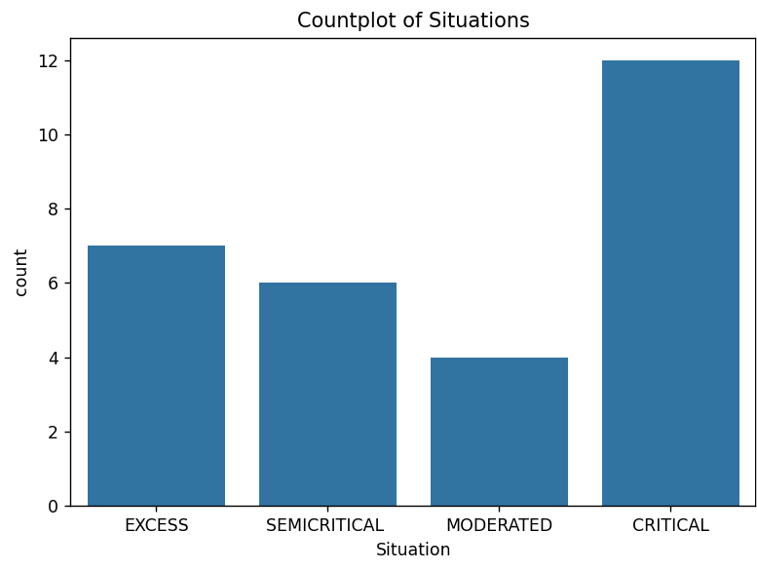

Slide 13
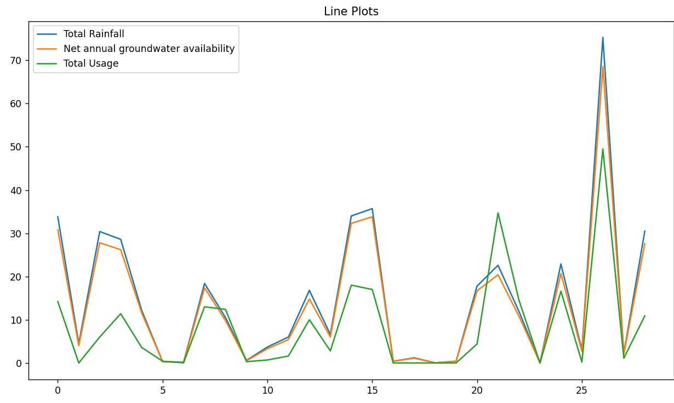

Slide 14
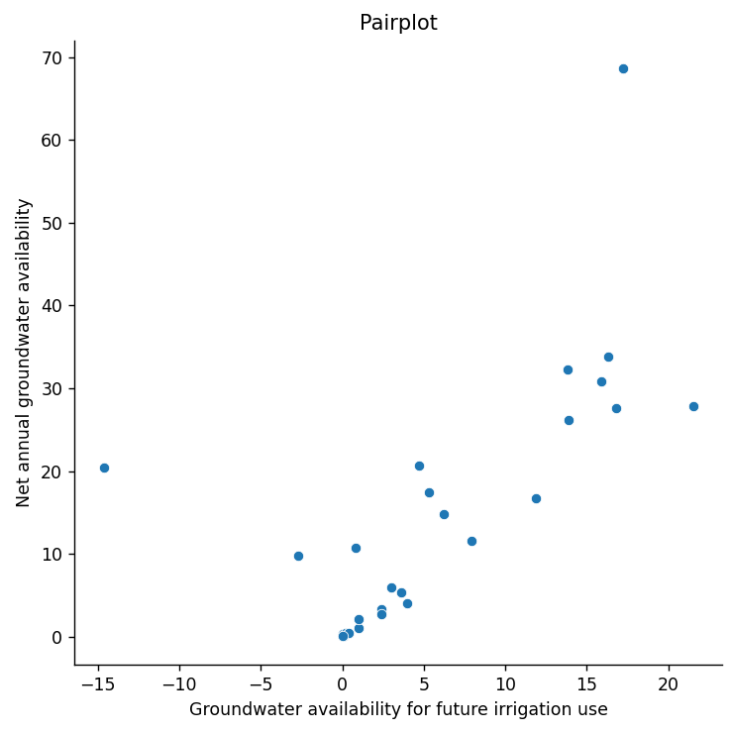

Slide 15
Conclusion
The study demonstrates the use of a logistic regression model to classify groundwater levels, offering a simple, cost-effective, and interpretable solution to aid in sustainable water management and informed decision-making.

Slide 16
References
Dataset from Kaggle.
Groundwater Prediction Using Machine Learning Tools – Groundwater Prediction Using Machine-Learning Tools.
Prediction of groundwater quality using efficient machine learning technique - Prediction of groundwater quality using efficient machine learning technique - ScienceDirect
*
Dept of CSE., SOE-Dayananda Sagar University

Slide 17
THANK YOU

